Slide 1
Implementing
Naviance Test Prep
Presented By:
Consultant, Hobsons

Slide 2

Naviance Test Prep provides proven, game-based learning to equip middle and high school students to perform their best on test day.
ACT Aspire™ | ACT® | SAT® | Advanced Placement®
Notes:
And, it integrates with Naviance, the world’s leading college and career readiness platform.

Slide 3








Introducing Naviance Test Prep
Gamified for Engagement
Intelligent Reporting
Designed to reward and motivate students
Students, teachers and administrators access information that’s right for them
What should I do now?
How am I doing?
How are my students doing?
How are my schools doing?
Premier Content
Created and regularly updated by subject matter experts
Notes:
Gamified for Engagement
As students answer questions correctly, they accumulate points and badges. These reinforcements positively reward students and help keep them motivated to persist. Micro-goals, based today’s study goals, help students complete the course in bite-sized units, and students can see their progress with the completion of every activity.
Premier Content
Content is continually refreshed by subject matter experts to the latest standards, including the new SAT. We don’t have to keep updating anything new from the testing agencies. We have Subject Matter Experts within each company that curate and update content.
Intelligent Reporting
Helps students, teachers, and administrators access the most critical information for them
Students can see how far along they are and what concepts need attention
Teachers and counselors can easily identify which students may need additional support on specific concepts.
District administrators can see progress by school and by classroom

Slide 4
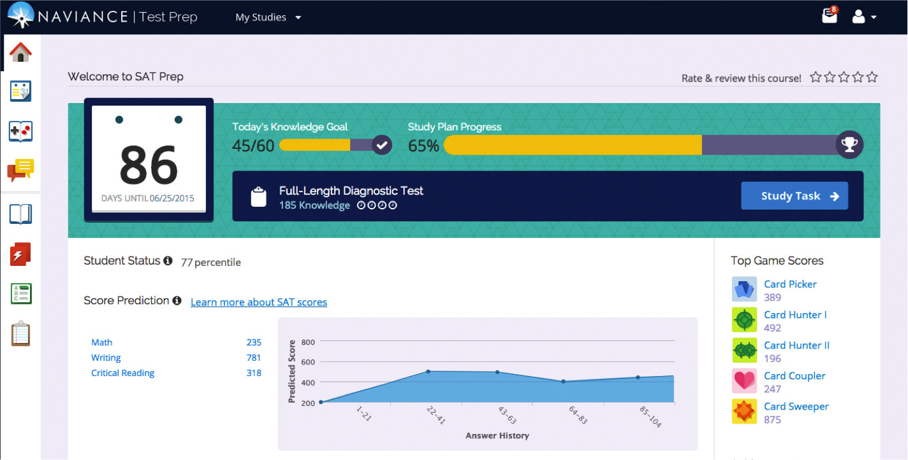
Student Home Screen
Notes:
Students will easily access Naviance Test Prep from Family Connection
Calendar shows actual test dates in RED
The first step is for students to take our diagnostic to determine the concepts they need to focus on
Can skip this on the structured plan
Let’s walk through a few screens
Student Status: status among all students using Test Prep
Percentile (98th percentile = 2nd rank, 99th percentile = 1st rank)
After 10 questions in each category they will get a score prediction, will change as the student keeps progressing and improving

Slide 5
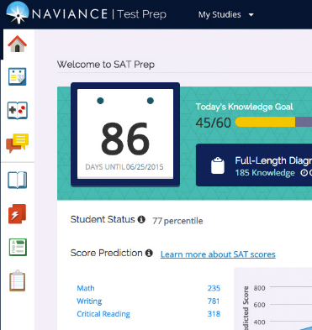

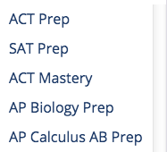
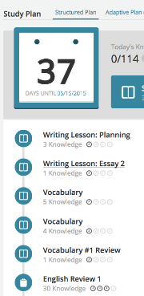
Getting Started
Study Plan
Choose a course
Today’s goal
Achieved vs. Target
Game Center
Discussions
Today’s task
Days until test day
Lessons
Flashcards
Quizzes
Practice Tests
Notes:
Students can easily see today’s “knowledge goals” – bite-sized units that they can complete.
As they move through the course, students can see their progress and how far they have to go (Achieved vs target)
They click “Study Task” and it takes them to the first task they must complete that day. This task comes from the study plan. The first study task will always be a diagnostic to gauge their strengths and weaknesses
Tabs:
Study Plan: The student’s roadmap – explained on next slide
Game Center: 5 games to choose from to keep learning fun
Discussions: Private discussions between student and instructor and group discussions are optional
Lessons: Table of contents for the entire course
Flashcards: Helpful study tool for every subject and content area. Schools can create their own custom set of flashcards if desired.
Quizzes: Practice questions that can be timed or untimed.
Practice Tests: Full-length, simulated practice tests (timed). 6 full tests for SAT and ACT and 2-5 for AP courses, depending on the subject.

Slide 6

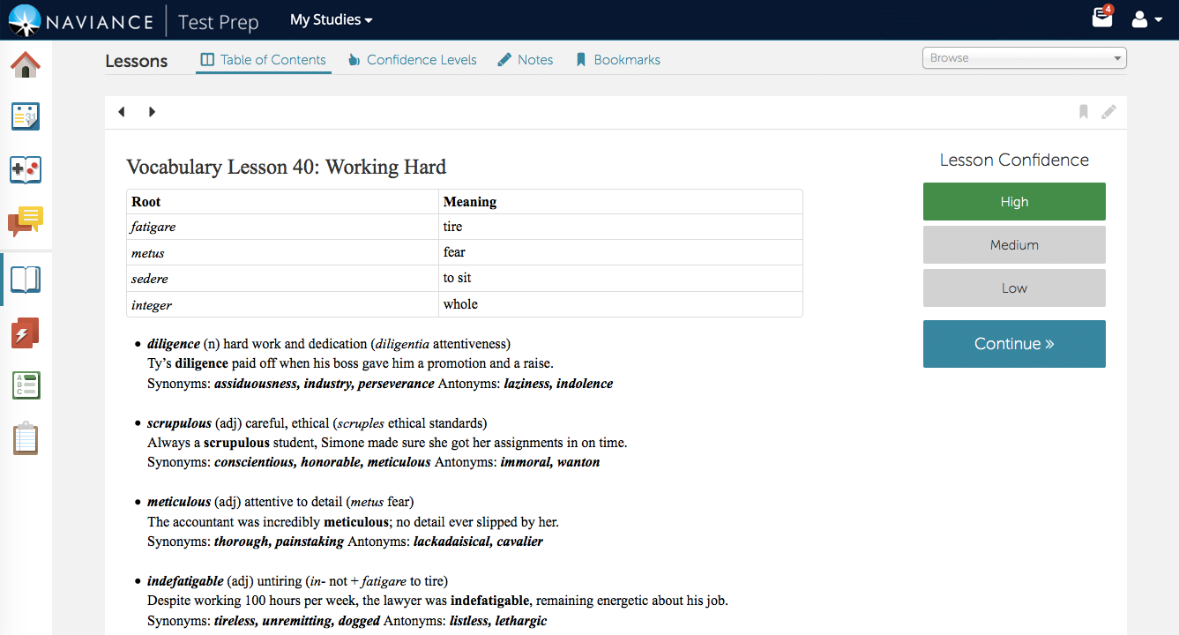
Study Plans: The Roadmap
Study Plan
Study Plans begin covering concepts based on the results of the diagnostic
Students Indicate their confidence level
Easily review all plan activities
Notes:
Students can view the concepts they will be studying on their study plan.
Here is a sample lesson. They begin by studying key concepts that the diagnostic indicates they need to work on.
When students indicate their confidence level, the platform includes review on the content that they need help with. The platform is constantly learning about the student and adjusting the study plan accordingly.
Students or teachers can choose the structured or adaptive study plan based on test date (which includes the complete course content).
If the student has at least 90-100 days they can complete the structured study plan. If they have less than this we need to recommend the adaptive plan.
AP Prep utilizes the structured study plan (entire course) by default. The reason is that students likely need to study the entire course material. They can choose the adaptive plan if they running short of time. We recommend they do the structured plan so they can complete the entire content. Advantage= it can be used in the classroom (students complete lesson, students can complete in homework, etc)

Slide 7
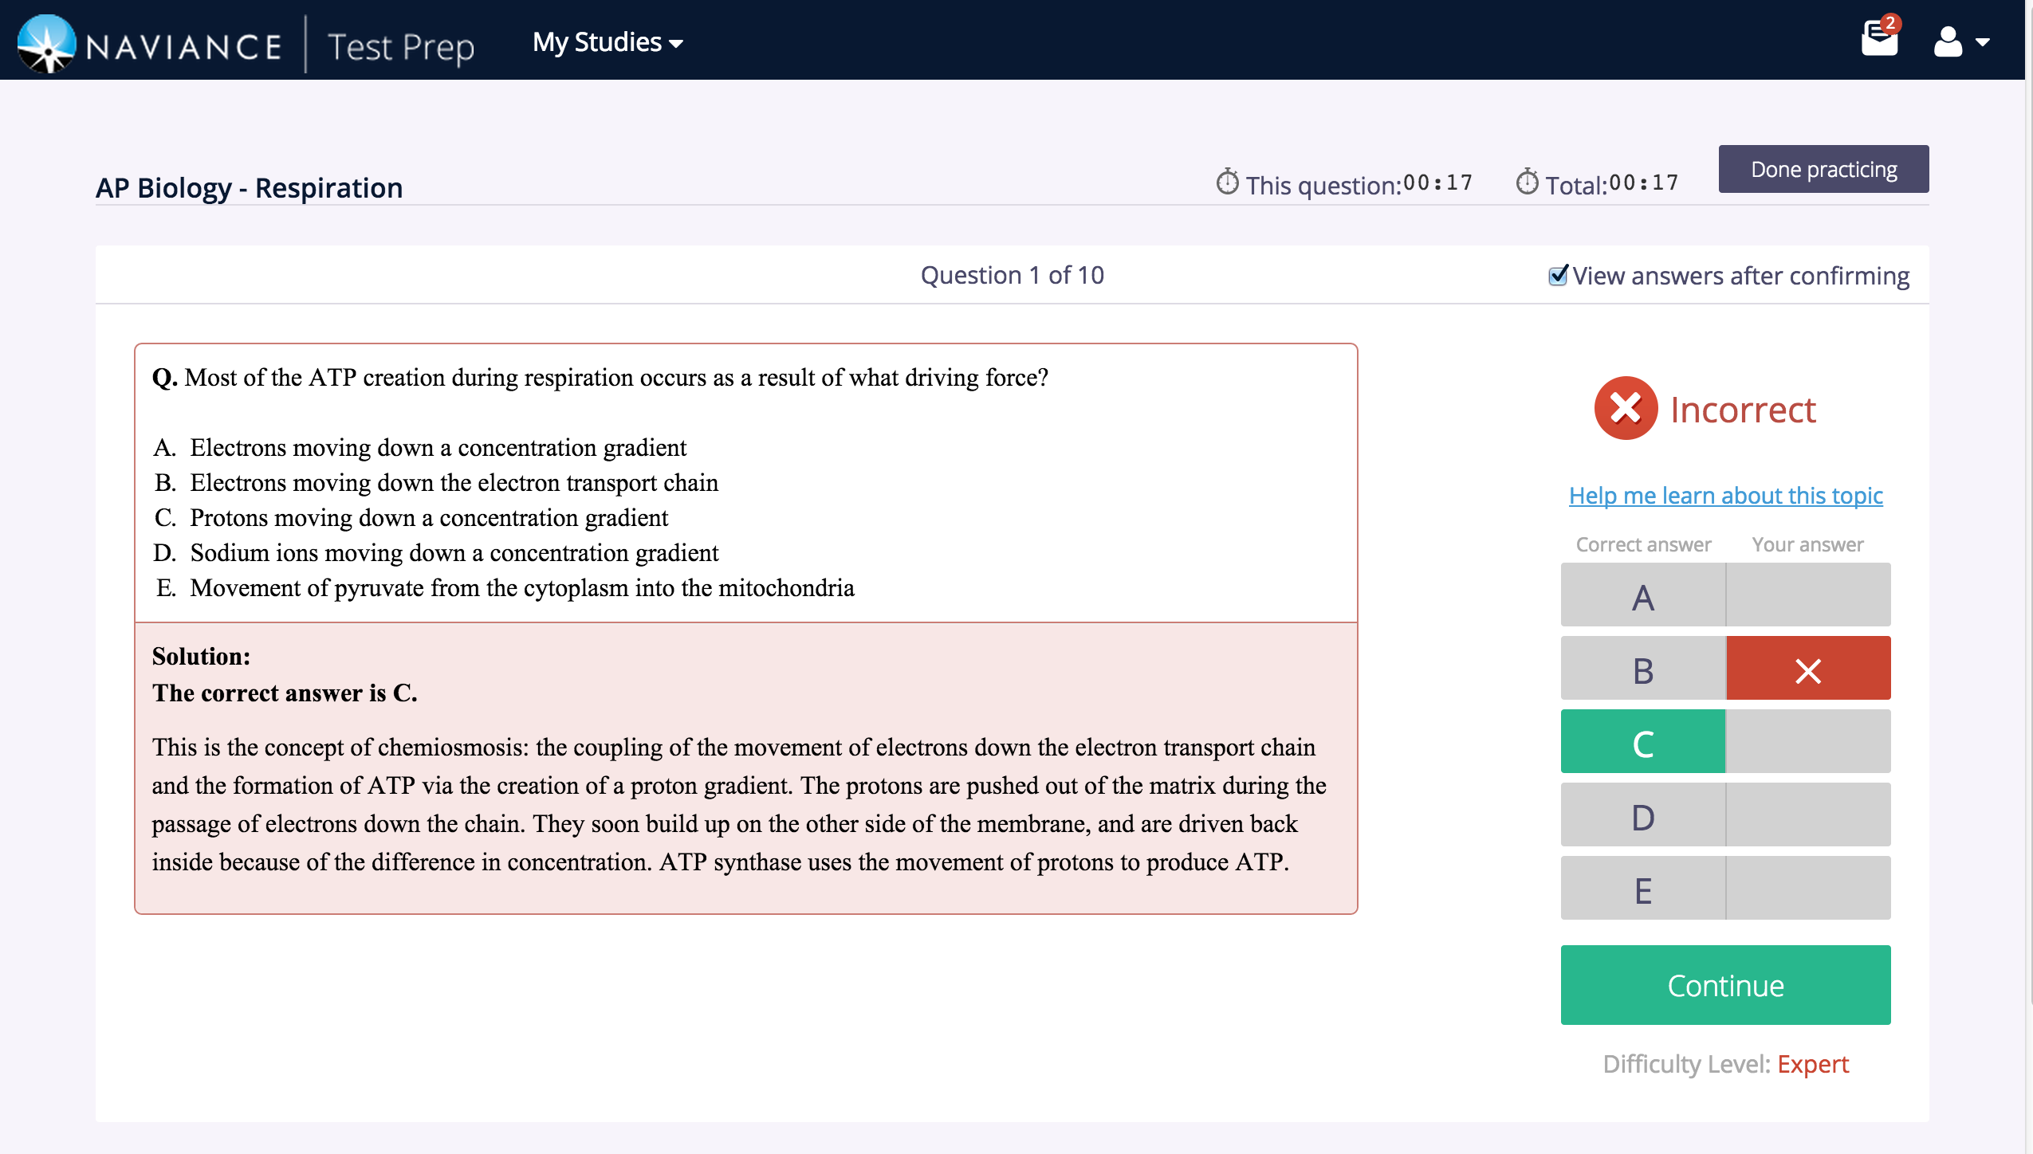
Support at Every Step
As students answer questions, the platform adapts
After studying, the platform then moves into practice questions
Quick review available on each concept
Answer explanations are included for both right and wrong answers
Notes:
After students indicate confidence levels on different topics, it’s time to practice. The study plan will automatically lead them into practice questions.
If they need help, they can quickly access additional review

Slide 8
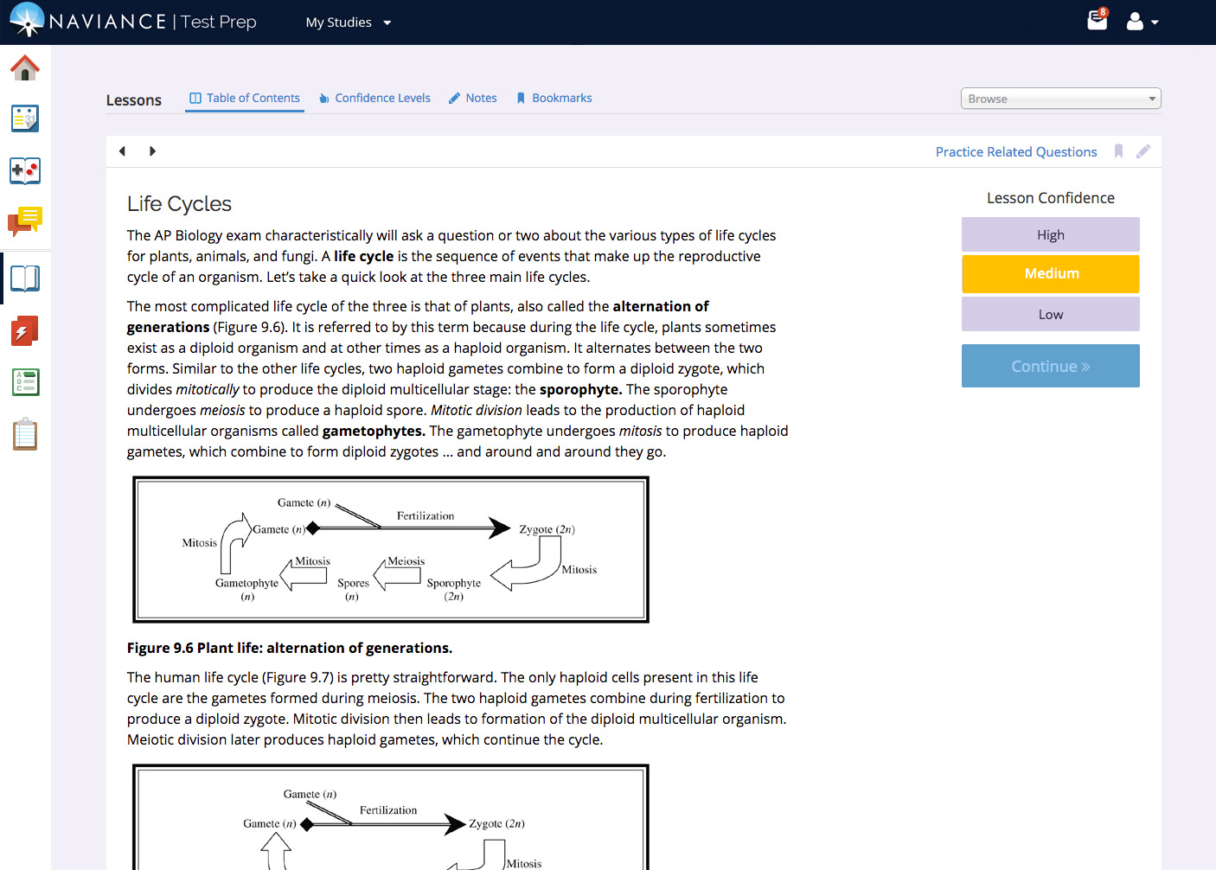
Active vs. Passive Learning
Bookmark key lessons
Jump to practice questions on this topic
Take notes
Notes:
Naviance Test Prep facilitates active vs. passive learning. Students can take notes, bookmark lessons, and indicate confidence lessons – all activities that build engagement with the courses so that they can review the most critical concepts for them as their test approaches
AP courses help students prepare for the AP exam AND provide supplemental study content for students throughout the year.

Slide 9
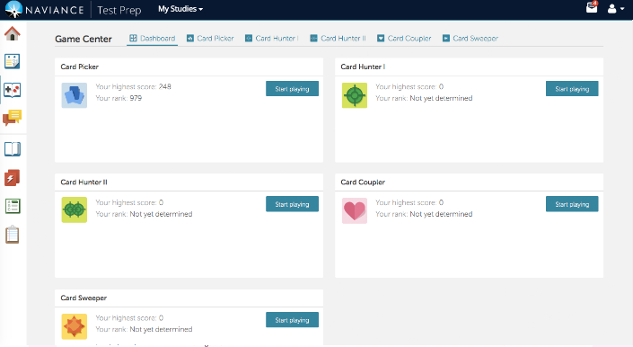
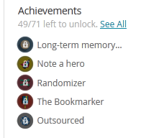
Gamified for greater engagement
The Game Center helps students learn faster and enhances memory retention
Positive reinforcements go a long way!
Addictive games build towards achievements, creating a positive emotional response as students answer more questions correctly. Games are aimed at helping students top your own high scores.
Notes:
Card-Based Games
Examples
Card Picker: A word displays, and you select the most appropriate match from the definitions given.
Card Coupler: A game similar to Minesweeper. You turn over cards which have a word or a definition. Then you first try to remember matches of words and their definitions. Students love the game

Slide 10
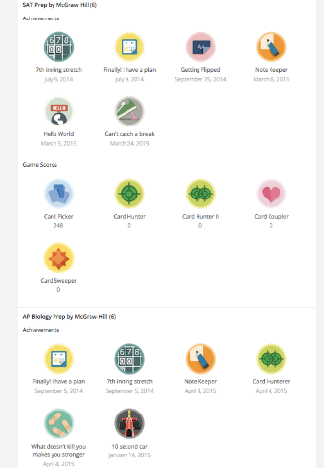
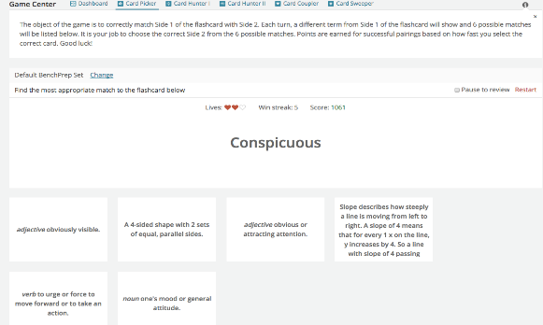
Achievements and Badges
Example Game: Card Picker
Students have “lives” and can try to top their own “win streaks”

Slide 11
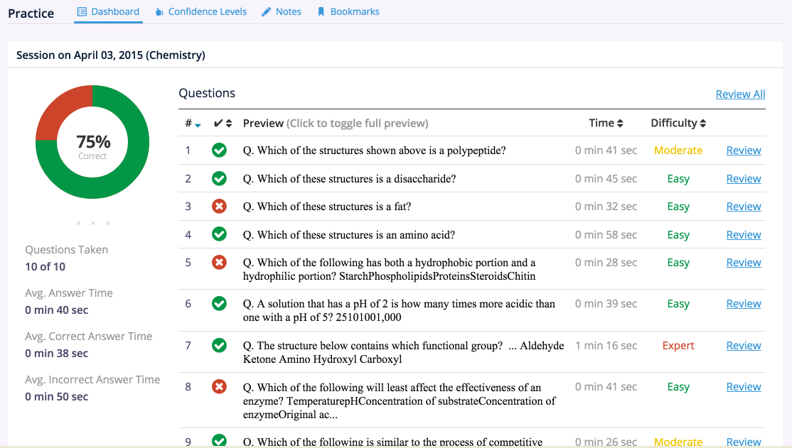
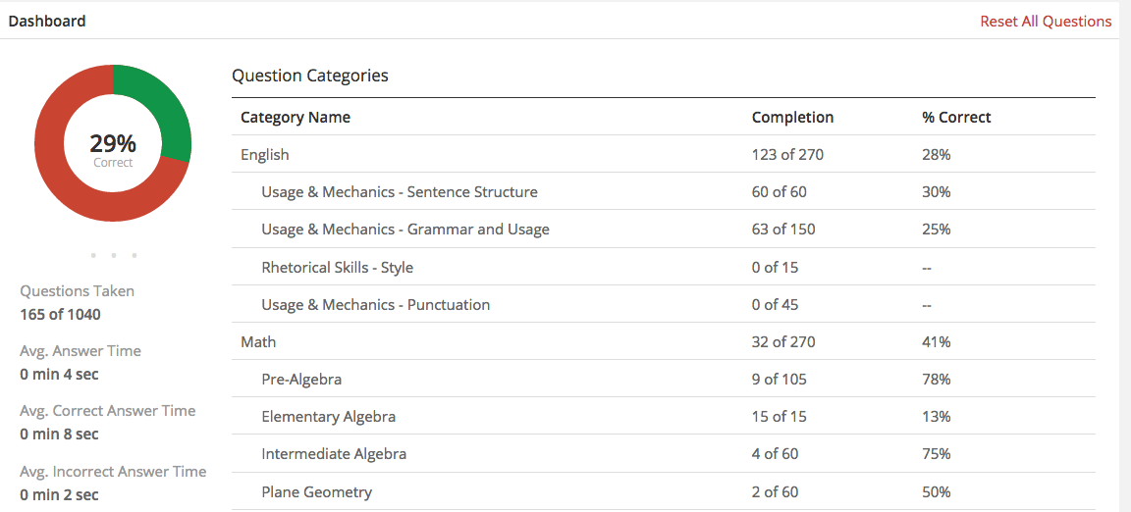
Understanding Progress
Lesson performance snapshot
Question Difficulty
Time Spent
Concept Mastery
Performance Metrics
Notes:
As students complete lessons, they will be able to review performance including basic metrics such as time spent and number correct and level of difficulty. This depends on all of the students in Naviance Test Prep.
Students can also see which concepts they are mastering (based off of the number answered correctly).

Slide 12
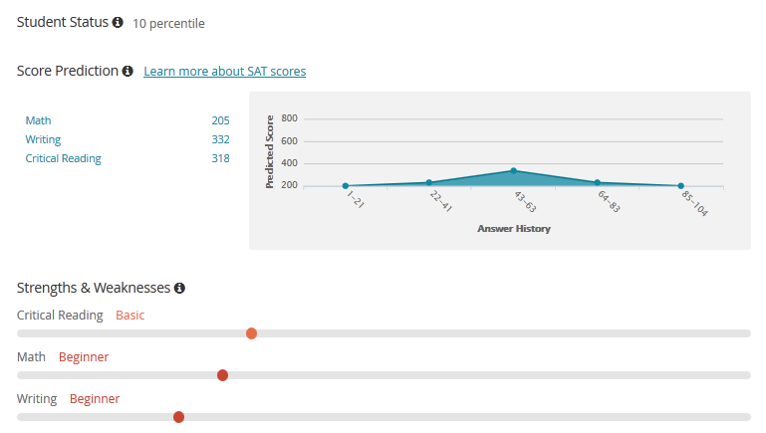
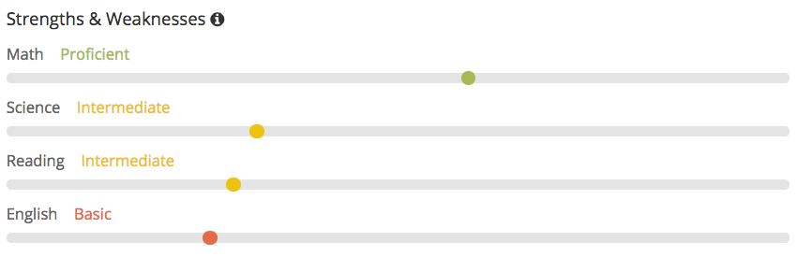
Focusing on What’s Next
View relative comparison to other Naviance students
Prognosticating test scores at every step
The graph shows the evolution of Score Prediction– students can see their score going up!
Snapshot showing strengths and areas of improvement
Notes:
The platform helps students see strengths and weaknesses. Students can drill down to see performance in specific areas
Score Predictions help them see their progress towards their desired score
The platform predicts the student’s score if they were to take the test today

Slide 13
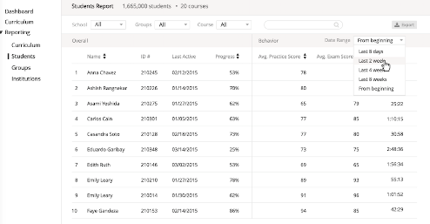
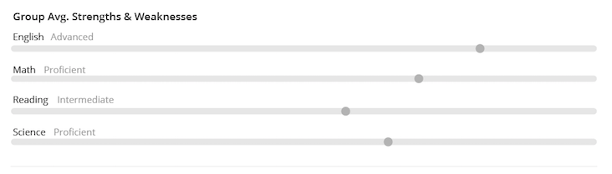
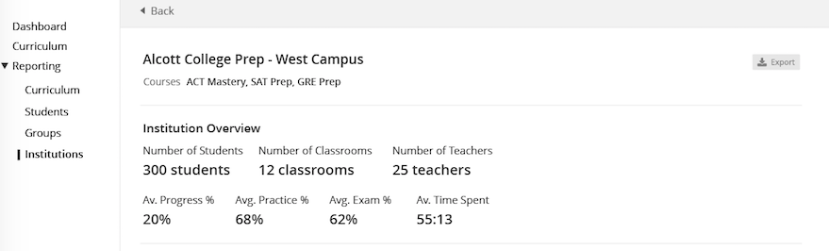
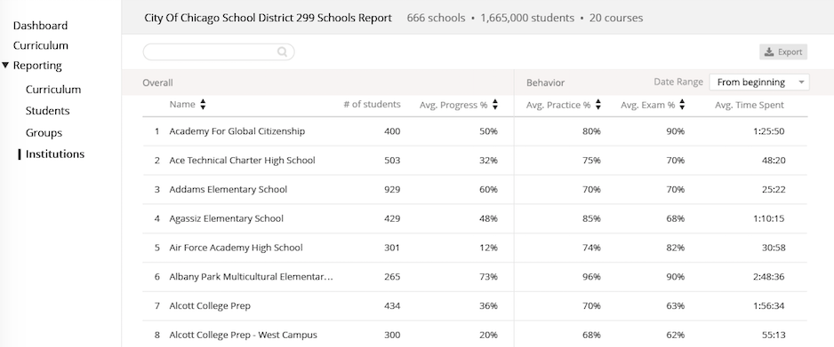
Teacher and Administrator Reports
Individual student progress
Classroom progress
School snapshot
District overview
Individual schools

